Slide 1
Blockchain Ownership

Slide 2

Hello!
Boyang Tang , Xingyao Zhao
xzha607@aucklanduni.ac.nz
btan766@aucklanduni.ac.nz

Slide 3
Major purpose of the Blockchain
The management of ownership is a prominent application case of the blockchain

Slide 4
The Role of Managing Ownership
Why the management of ownership of digital goods is the most discussed application of the blockchain
(e.g., Bitcoin or managing ownership of cryptographic money)
Easier to understand and explain
It is the use case with the most impact on the economy

Slide 5
“Have you ever thought about what makes you the owner of the things that
belong to you?”
How can you prove that?

Slide 6
Ownership and Witness
Proving your Ownership
It would be great help if somone could tesify.
Having one witnesses is good, but having many independent witnesses could be better.
The idea behind the blockchian
The more independent witnesses who testify to the same fact, the higher the chance that this fact us indeed true.

Slide 7
Fundations of Ownership
An identification of the owner
We can identify people with ID cards, birth certificates, and drive licenses
An identification of the object being owned
Serial numbers, production dates, production certificates, or a detailed description can be used to identify objects
A mapping of the owner to the object
The mapping between owners and objects is typically done with a ledger or register.

Slide 8
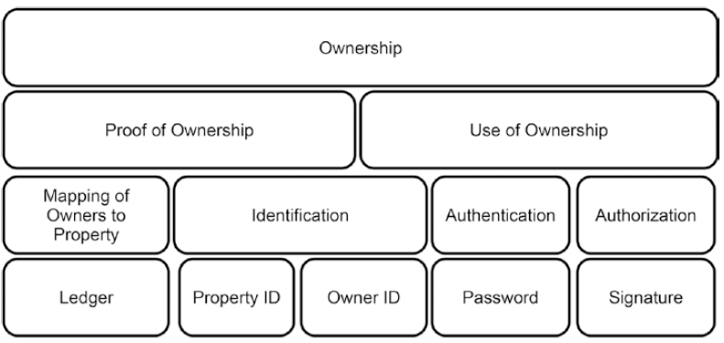
Password
Signuature
(are used for)
Authentication
Authorization
Use of Ownership
Ledger
Property ID
Owner ID
(are used for)
Mapping
Identification
Proof of Ownership

Slide 9
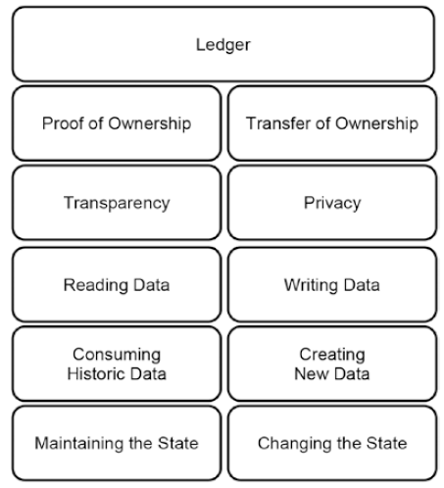
Purposes and Properties of a Ledger
Proof of Ownership
-- transparency is the basis of proving ownership rights in a similar way as witnessed making a public testimony in court.
Transferring ownership
-- privacy forms the basis of transferring ownership. Since writing in the ledger means changing ownership, only very trustful entities should be given writing access to ledgers.

Slide 10
Ownership and the Blockchain
Traditionally, a witness in the form of a government-regulated leger is the key in clarifying ownership of goods.
Risk:
-- but what happens if such a ledger is damaged or destroyed?
-- if someone responsible for updating the ledger makes an error or forges it on purpose?
In this case, the ledger does not reflect reality.
Having more witness is better.
The more independent witnesses who are interrogated, the higher the chance that those facts are consistently mentioned among the majority of testimonies reflect the truth.
The blockchain is a consensus system, utilizing a pure distributed peer-to-peer system of ledgers and clarify requests concerning on that version of the reality on which the majority of peers agrees.

Slide 11
Double Spending
Users trust a system if the system is considered as reliable and accurate
Managing ownership and system integrity are key
Notes:
--Spend a dollar = get a dollar worth of whatever
--Spend a dollar = get two dollars or half a dollar worth of whatever => not trustworthy

Slide 12

Double Spending in Distributed System
Node AS
Node NA
Node AF
Node SA
Node NZ
Notes:
Time difference between nodes get updated
Auckland vs Wellington vs Christchurch
Anyone who has the latest information can exploit
Seller can sell the same car multiple times
This is the situation where double spending occurs

Slide 13
Bitcoin Network
Race Attack
Finney Attack
Vector76 Attack
Alternative History Attack
Majority Attack

Slide 14
Race Attack
Target at merchant that completes transaction straightaway
Wait for 1 confirmation

Slide 15
Finney Attack
Merchant has got confirmation and sent good
Attacker successfully mines and extends another branch with a different transaction
The new branch is broadcasted – merchant ends up with no money nor good

Slide 16
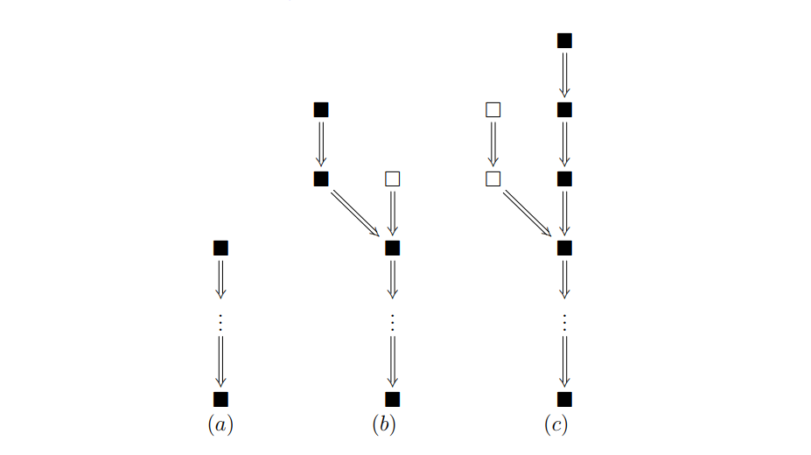
Finney Attack

Slide 17
Catch-up Game
Notes:
Ultimately comes down to which chain is the longest.

Slide 18
Catch-up Game
Attacker’s computational power – q
Honest miner’s computational power – p
q + p = 1
Appearance of blocks follow poisson distribution

Slide 19
Successful Attack
Attacker: Poisson(q) -> n blocks
Honest miner: Poisson(p) -> m blocks
What is the probability that n > m?

Slide 20
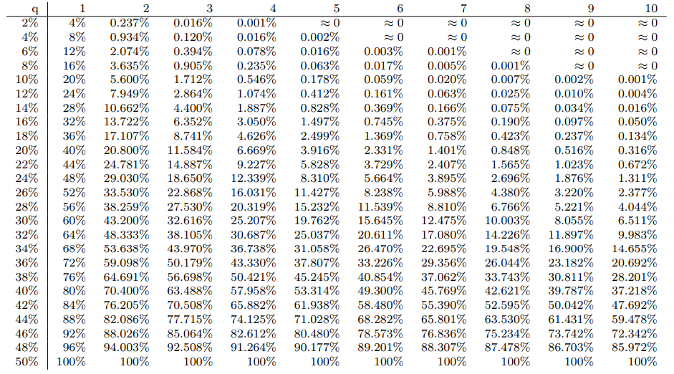
Successful Attack

Slide 21
Handling Double Spending
System Integrity
Interaction with the system will not be flawed thus transactions will take place.
Mapping of Ownership
Ledger that records ownership information will be trusted.
Enforcement of Ownership Rights
One to one exchange of digital currency and digital asset.

Slide 22
Let’s review some concepts
Foundations of ownership
Identification of the owner
Identification of the object being owned
Mapping the owner to the object
Ownership & Blockchain
The blockchian is responsible for letting the individual nodes collectively arrive at one consistent version of the state of ownership
Double Spending
System is trustworthy if people know double spending is handled
Bitcoin Network
Race Attack
Finney Attack

Slide 23
Boundary of Study
No mention of how the technology will be implemented in real world
Double spending is not the only type of problem that violates system integrity

Slide 24

Thanks!
Any questions?

Slide 25
Reference
Analysis of hashrate-based double-spending, Meni Rosenfeld 2012
https://bitcoil.co.il/Doublespend.pdf
Bitcoin Basics, Daniel Drescher

